Slide 1
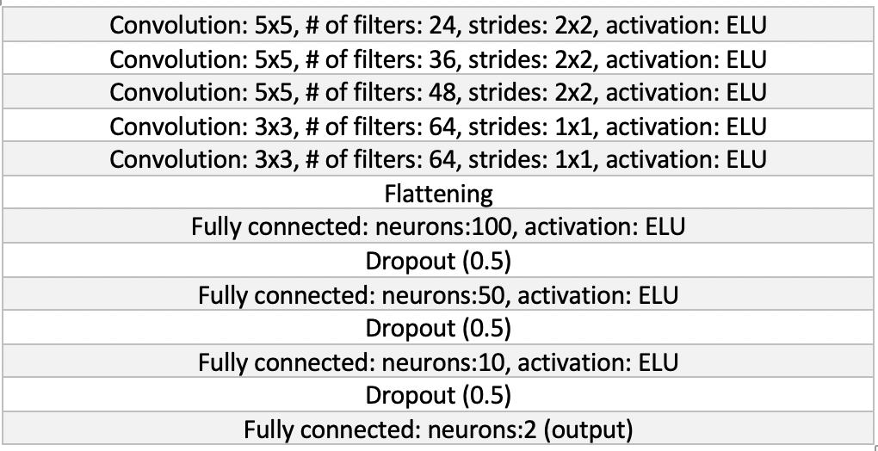
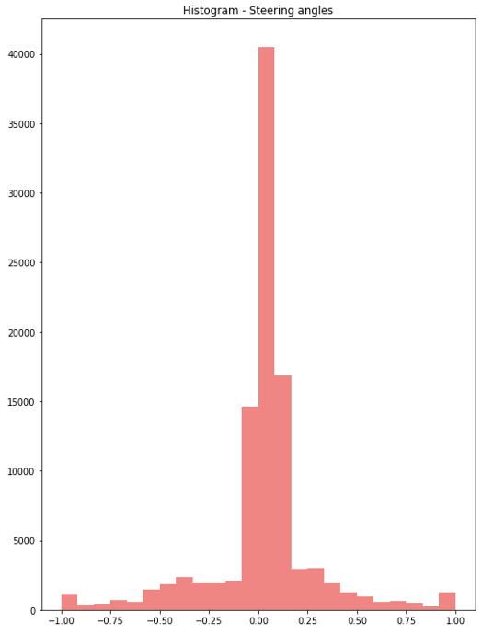
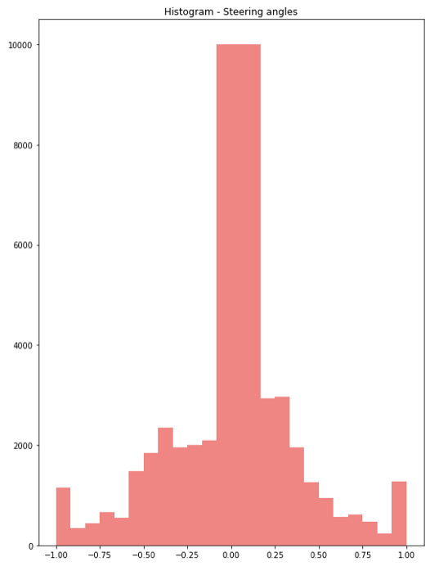
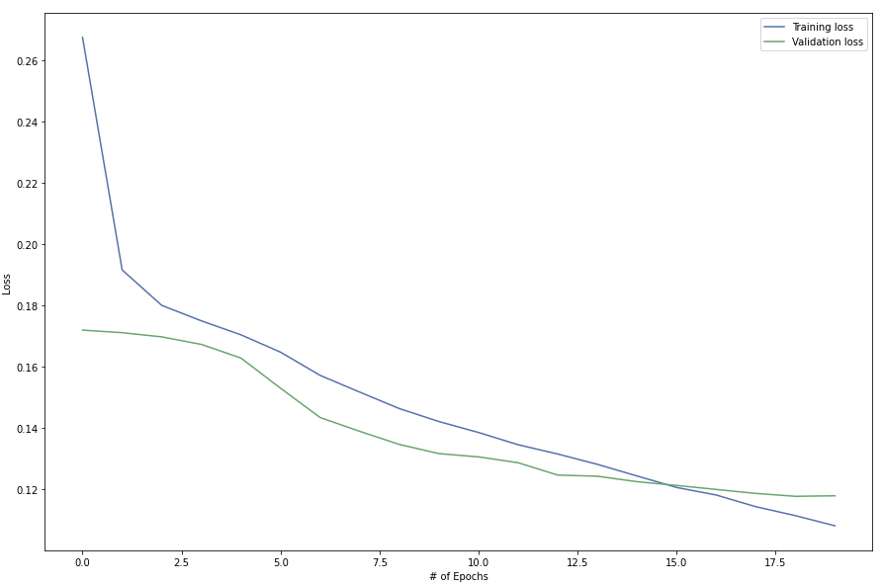
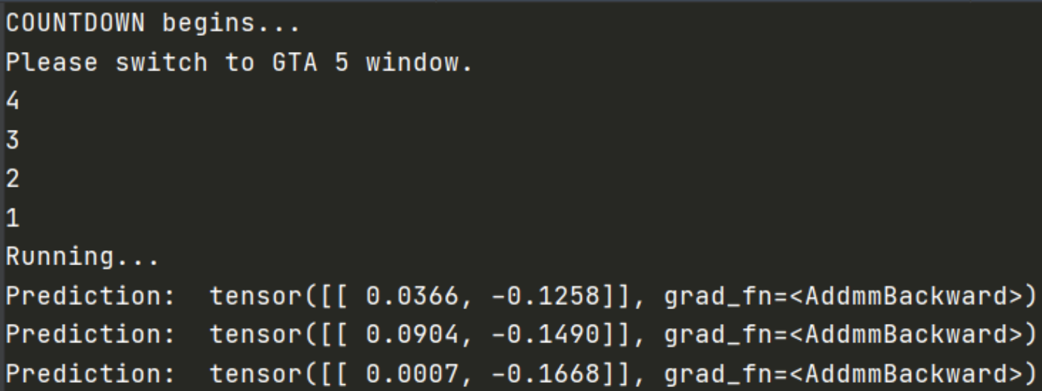
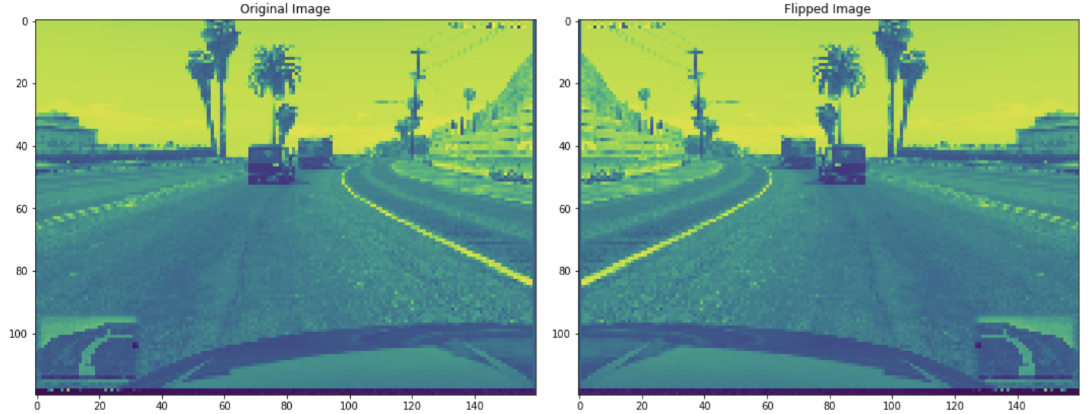
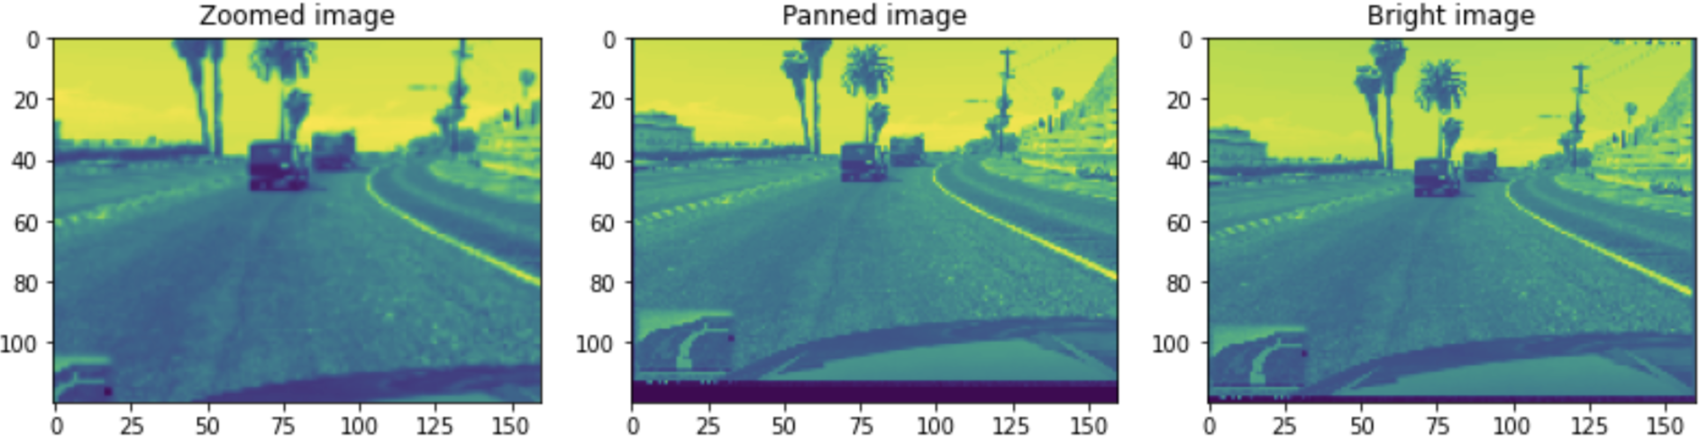
[Paper Name] Font: Arial Bold, Font Size: 80pt,
Color: Red, Align: Center]
First_Name Last_Name Affiliation email | First_Name Last_Name Affiliation email | First_Name Last_Name Affiliation email
Introduction
Objective and dataset description
Methodology
Starting with data pre-processing and image transformations.
Neural Network based model training
Describe model and compared with baseline models like Comma.ai’s steering angle predictor.
`
Final Model Architecture
Results
Describe about optimizer, batch size, epochs and any other hyperparameters.
Unbalanced steer angle targets Balanced steer angle targets
Model Performance – MSE Loss
On deployment of trained model for real-time game predictions using external dependencies, following are the model outputs to steer the car automatically.
Console Output Window - Testing
Conclusion
write concluding remarks
takeaways like importance of image data transformations, in-depth knowledge of mini-batch, activation function, learning rate, gradient descent with momentum for accurate testing results, requirement of GPU for heavy model training processes, and finally deployment of model for real time game play predictions with external dependencies. Exciting and fun!
Future scope
Image transformations – Data Augmentation
Paper ID: xxxx

